Slide 1







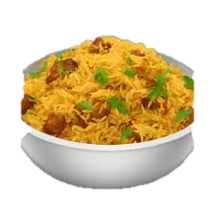
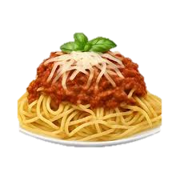











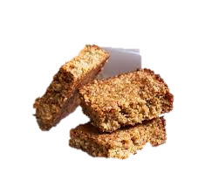



Gayhurst Community School
MENU
 | Monday | Tuesday | Wednesday | Thursday | Friday
MAIN Option 1 | Farfalle Pasta in Rich Tomato Sauce & fresh Basil *Gluten | Goan Chicken Curry, Garlic, Ginger, Paprika Pilaf Rice | Indian Chickpea Biryani | Slow cooked Beef Ragout, Casareccia Pasta *Gluten, Celery | Lemon-Herbs Fish Goujons Tartare sauce *Gluten, Fish, Eggs
MAIN Option 2 (vegetarian) | Farfalle Pasta, Italian Basil pesto, Roast Sunflower seeds *Gluten | Goan Paneer & Potatoes Curry *Milk | Brown Rice | Spinach, leek ,Potatoes Quiche *Gluten, Milk | Stuffed Tomato, Rice, Mint
To Accompany | Rocket Salad, Parmesan, Datterino * Milk, Mustard | Coleslaw | Cucumber/Mint Raita * Milk | Lamb Lettuce & Watercress *Mustard | Kachumber Salad
Bread | Freshly Baked Bread *Gluten | Freshly Baked Bread *Gluten | Pitta Bread *Gluten | Freshly Baked Bread *Gluten | Freshly Baked Bread *Gluten
Vegetables | Roasted Garlic Spring Green | Roasted New Potatoes | Braised Savoy Cabbage | Roasted Broccoli | Potatoes, wedges, Herbs
On the Table | Hummus + Crudites | Hummus + Crudites | Hummus + Crudites | Hummus + Crudites | Hummus + Crudites
Dessert | Seasonal Fruits Salad | Lemon Drizzle, Poppy seeds *Gluten, Eggs | Seasonal Fruits Salad | Figs & Dates Flapjack *Gluten, Eggs | Seasonal Fruits Salad
* Allergens are in italics and marked with an Asterix / Please check Fresh Salad & Fruit ingredients with the Kitchen team

